Slide 1

TASHI GLOBAL
Product Catalogue
Connecting Agriculture. Growing Opportunity.
Tashi Global Trading Company Limited
24 products | General varieties & buying guidance
tashiglobal.com | 1
Notes:
Company information supplied by Tashi Global. Product descriptions adapted from the approved website. AI-generated product images are illustrations. Product descriptions are general buying guidance. Varieties, origin, availability, quality limits, packaging, quantity, price and delivery terms are confirmed in the quotation and contract. AI-generated images are illustrative and do not represent a specific shipment.

Slide 2
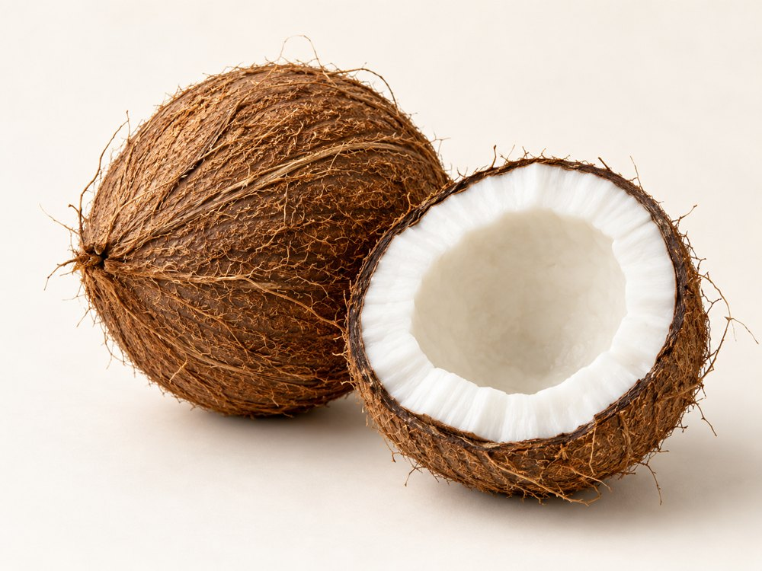
TASHI GLOBAL
Coconut
VARIETIES & FORMS
Tall types for mature kernels; dwarf types for tender-nut enquiries; named tall–dwarf hybrids.
BUYING SPECIFICATIONS & USES
Agree maturity, husked form, nut weight and kernel condition. Used for fresh coconut water, culinary kernel and processing.
HANDLING
Agree maturity, ventilation and temperature for the product and journey. Protect from bruising and confirm the required cold chain.
tashiglobal.com | 2
Notes:
Company information supplied by Tashi Global. Product descriptions adapted from the approved website. AI-generated product images are illustrations. Product descriptions are general buying guidance. Varieties, origin, availability, quality limits, packaging, quantity, price and delivery terms are confirmed in the quotation and contract. AI-generated images are illustrative and do not represent a specific shipment.

Slide 3
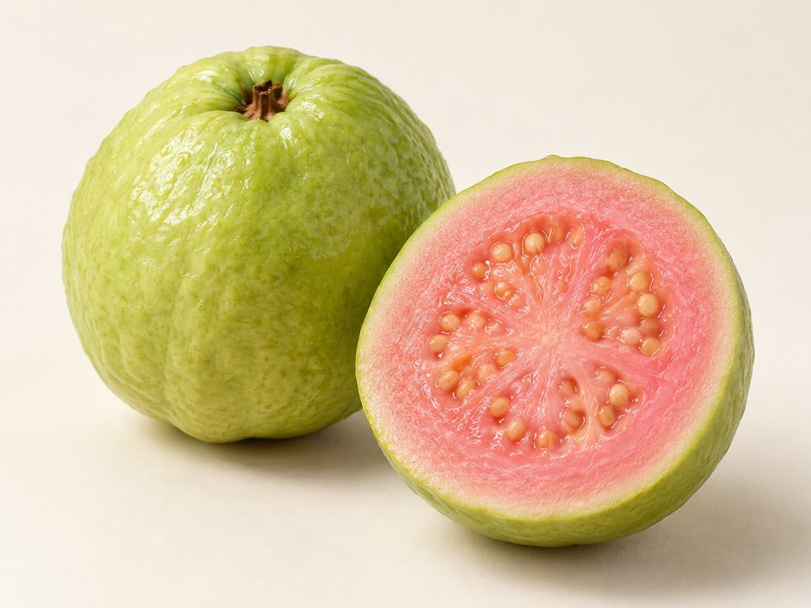
TASHI GLOBAL
Guava
VARIETIES & FORMS
White-flesh types; pink or red-flesh types; named cultivars such as Beaumont. Seed content varies.
BUYING SPECIFICATIONS & USES
Specify flesh colour, firmness, fruit weight and ripeness. Suitable for fresh eating, juice, purée and preserves.
HANDLING
Agree maturity, ventilation and temperature for the product and journey. Protect from bruising and confirm the required cold chain.
tashiglobal.com | 3
Notes:
Company information supplied by Tashi Global. Product descriptions adapted from the approved website. AI-generated product images are illustrations. Product descriptions are general buying guidance. Varieties, origin, availability, quality limits, packaging, quantity, price and delivery terms are confirmed in the quotation and contract. AI-generated images are illustrative and do not represent a specific shipment.

Slide 4
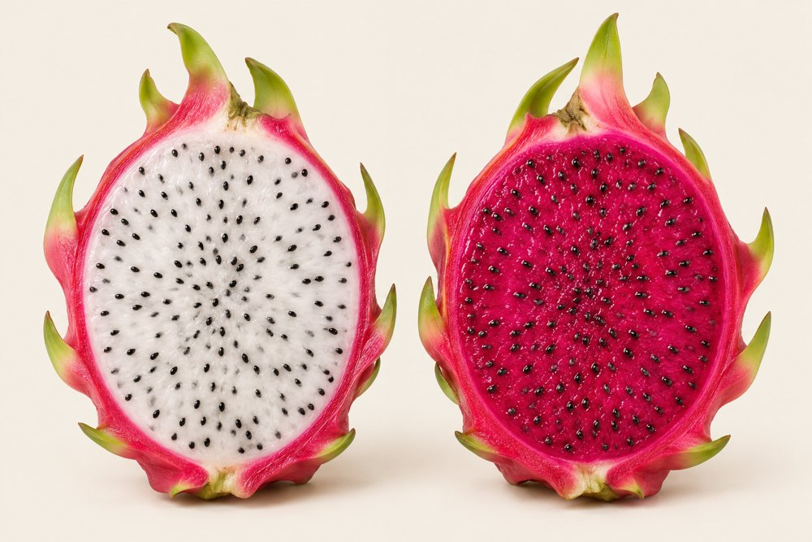
TASHI GLOBAL
Dragon Fruit
VARIETIES & FORMS
Red skin with white flesh; red skin with red or purple flesh; yellow skin with white flesh.
BUYING SPECIFICATIONS & USES
Agree fruit weight, flesh colour, maturity, sweetness and skin condition. Used fresh, in beverages and desserts.
HANDLING
Agree maturity, ventilation and temperature for the product and journey. Protect from bruising and confirm the required cold chain.
tashiglobal.com | 4
Notes:
Company information supplied by Tashi Global. Product descriptions adapted from the approved website. AI-generated product images are illustrations. Product descriptions are general buying guidance. Varieties, origin, availability, quality limits, packaging, quantity, price and delivery terms are confirmed in the quotation and contract. AI-generated images are illustrative and do not represent a specific shipment.

Slide 5
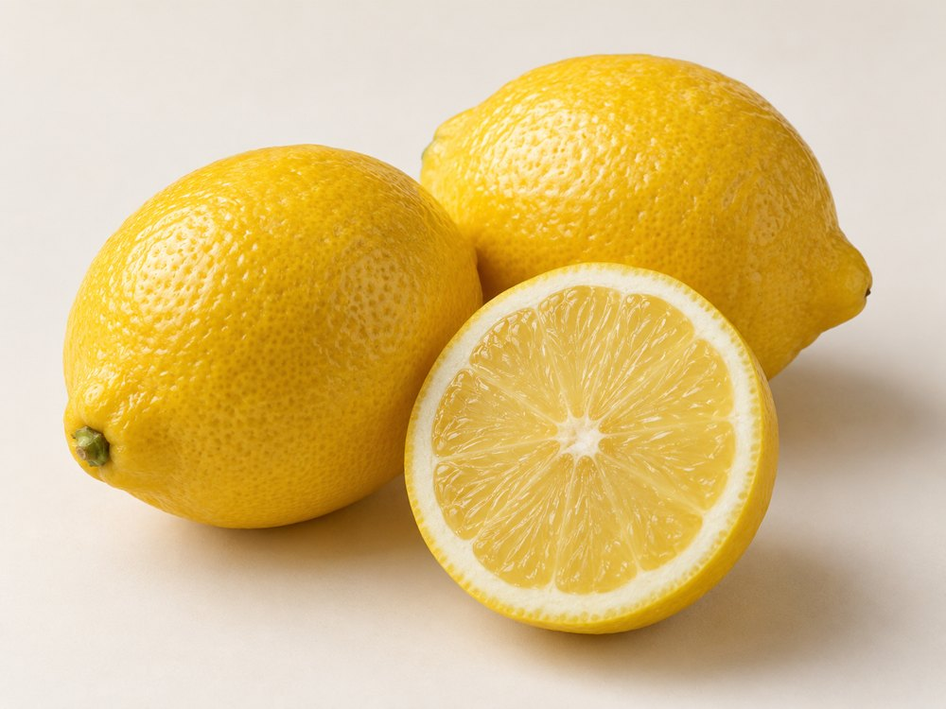
TASHI GLOBAL
Lemon & Seedless Lime
VARIETIES & FORMS
Eureka and Lisbon lemons; Meyer citrus hybrid; Persian / Tahiti lime, a separate citrus type that is normally seedless.
BUYING SPECIFICATIONS & USES
Agree size, skin colour, juice content and seed tolerance. Handling differs between lemons and limes; used in food and beverages.
HANDLING
Agree maturity, ventilation and temperature for the product and journey. Protect from bruising and confirm the required cold chain.
tashiglobal.com | 5
Notes:
Company information supplied by Tashi Global. Product descriptions adapted from the approved website. AI-generated product images are illustrations. Product descriptions are general buying guidance. Varieties, origin, availability, quality limits, packaging, quantity, price and delivery terms are confirmed in the quotation and contract. AI-generated images are illustrative and do not represent a specific shipment.

Slide 6
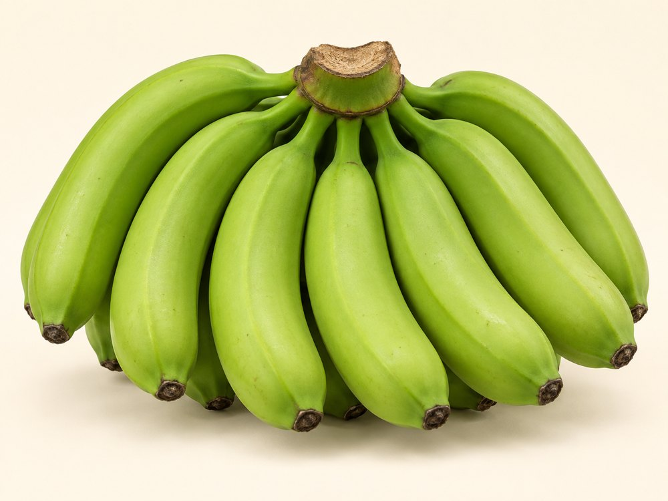
TASHI GLOBAL
Bananas
VARIETIES & FORMS
Cavendish dessert-banana group; smaller Lady Finger / Pome types; red-skinned bananas. Image: green Cavendish.
BUYING SPECIFICATIONS & USES
Specify finger size, green or ripened delivery stage, crown condition and carton weight for wholesale or retail.
HANDLING
Agree maturity, ventilation and temperature for the product and journey. Protect from bruising and confirm the required cold chain.
tashiglobal.com | 6
Notes:
Company information supplied by Tashi Global. Product descriptions adapted from the approved website. AI-generated product images are illustrations. Product descriptions are general buying guidance. Varieties, origin, availability, quality limits, packaging, quantity, price and delivery terms are confirmed in the quotation and contract. AI-generated images are illustrative and do not represent a specific shipment.

Slide 7
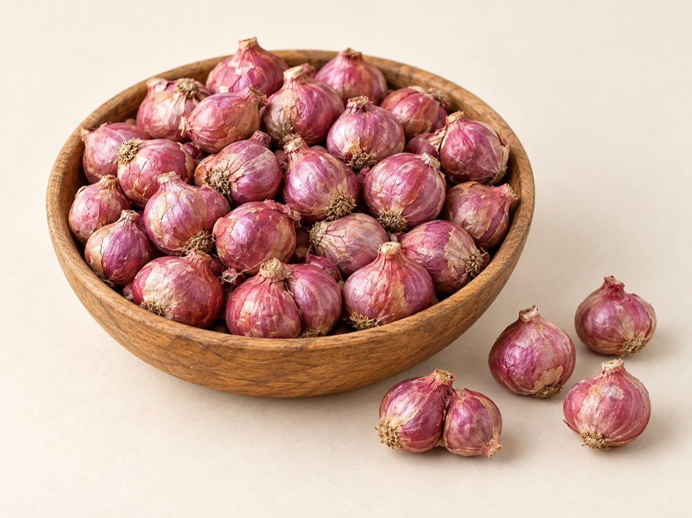
TASHI GLOBAL
Podisu Shallot Onion
VARIETIES & FORMS
Small Indian multiplier shallots, also called sambar onions. Named selections include CO types and MDU 1.
BUYING SPECIFICATIONS & USES
Agree bulb diameter, cured condition, colour, cluster separation and sprouting limits. Used in curries, sauces and pickles.
HANDLING
Keep dry and protected from moisture, pests and contamination. Agree ventilation and storage conditions for the supplied form.
tashiglobal.com | 7
Notes:
Company information supplied by Tashi Global. Product descriptions adapted from the approved website. AI-generated product images are illustrations. Product descriptions are general buying guidance. Varieties, origin, availability, quality limits, packaging, quantity, price and delivery terms are confirmed in the quotation and contract. AI-generated images are illustrative and do not represent a specific shipment.

Slide 8
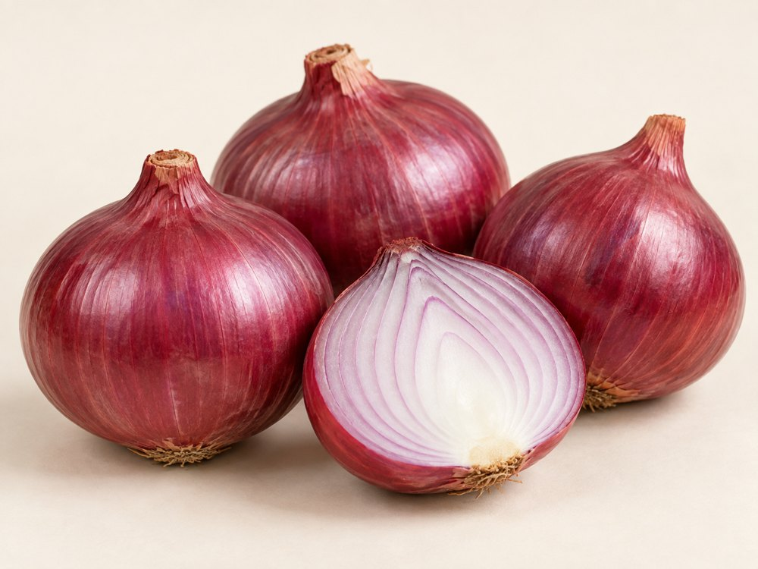
TASHI GLOBAL
Nasik Onion
VARIETIES & FORMS
Dark-red and light-red selections, graded by size. Nasik / Nashik is a regional trade name; confirm cultivar separately.
BUYING SPECIFICATIONS & USES
Specify diameter, firmness, dry necks, skin retention and sprouting limits. Suitable for fresh trade and cooking.
HANDLING
Keep dry and protected from moisture, pests and contamination. Agree ventilation and storage conditions for the supplied form.
tashiglobal.com | 8
Notes:
Company information supplied by Tashi Global. Product descriptions adapted from the approved website. AI-generated product images are illustrations. Product descriptions are general buying guidance. Varieties, origin, availability, quality limits, packaging, quantity, price and delivery terms are confirmed in the quotation and contract. AI-generated images are illustrative and do not represent a specific shipment.

Slide 9
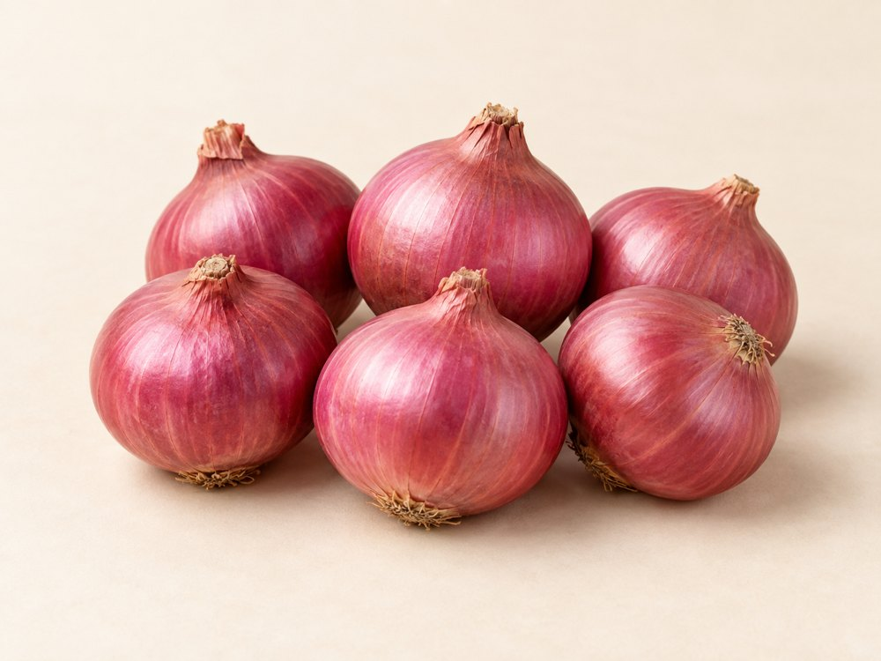
TASHI GLOBAL
Bangalore Rose Onions
VARIETIES & FORMS
A named small rose-onion type. Whole cured bulbs can be selected into smaller and larger grades.
BUYING SPECIFICATIONS & USES
Confirm type, origin, diameter, firmness and dry skin. Used for cooking, pickling and specialty produce markets.
HANDLING
Keep dry and protected from moisture, pests and contamination. Agree ventilation and storage conditions for the supplied form.
tashiglobal.com | 9
Notes:
Company information supplied by Tashi Global. Product descriptions adapted from the approved website. AI-generated product images are illustrations. Product descriptions are general buying guidance. Varieties, origin, availability, quality limits, packaging, quantity, price and delivery terms are confirmed in the quotation and contract. AI-generated images are illustrative and do not represent a specific shipment.

Slide 10
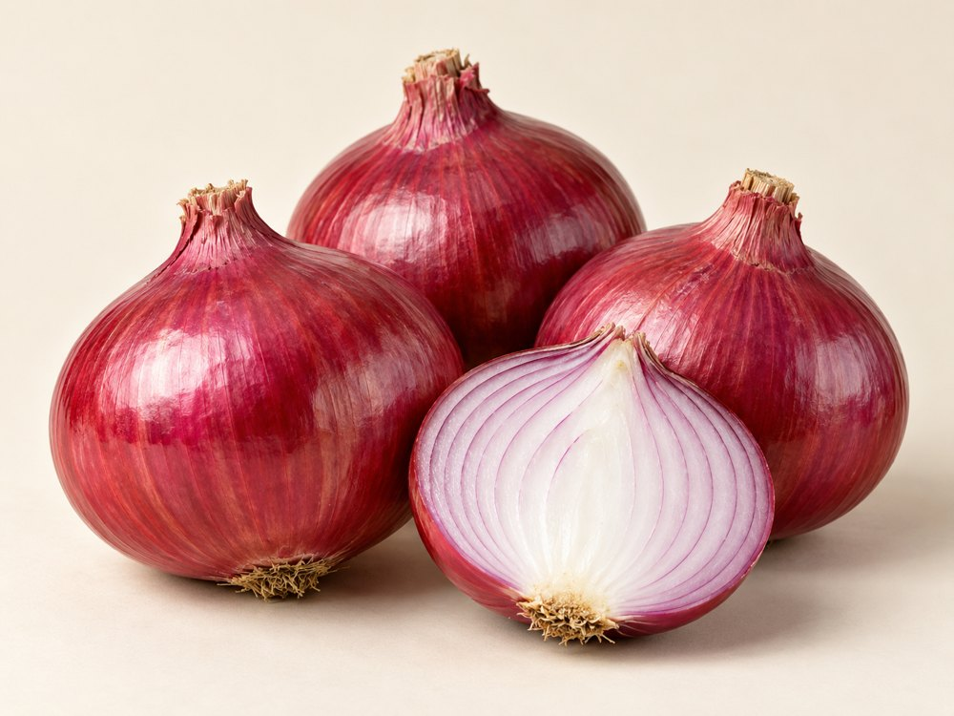
TASHI GLOBAL
Bellary Onion
VARIETIES & FORMS
Red bulb types in medium and large grades. Bellary is a regional / trade description rather than a complete cultivar specification.
BUYING SPECIFICATIONS & USES
Agree cultivar, size, colour, curing and damage limits for wholesale, foodservice or processing.
HANDLING
Keep dry and protected from moisture, pests and contamination. Agree ventilation and storage conditions for the supplied form.
tashiglobal.com | 10
Notes:
Company information supplied by Tashi Global. Product descriptions adapted from the approved website. AI-generated product images are illustrations. Product descriptions are general buying guidance. Varieties, origin, availability, quality limits, packaging, quantity, price and delivery terms are confirmed in the quotation and contract. AI-generated images are illustrative and do not represent a specific shipment.

Slide 11
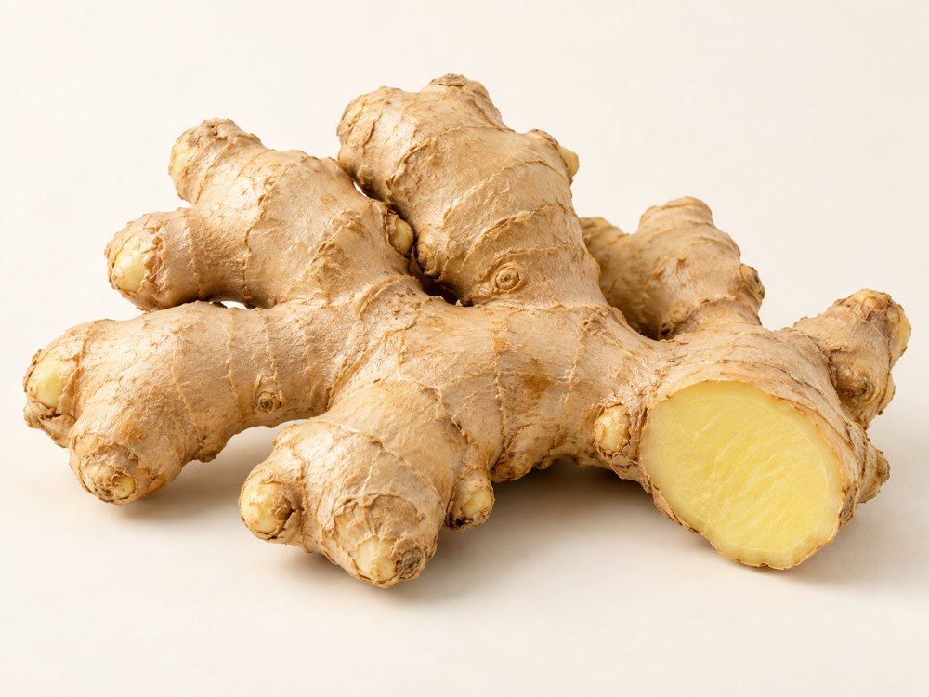
TASHI GLOBAL
Ginger
VARIETIES & FORMS
Varada: plump fingers. Mahima: extra-bold rhizomes. Rejatha: bold rhizomes. Fresh, dried, sliced or powdered forms.
BUYING SPECIFICATIONS & USES
Specify form, maturity, finger size, fibre preference and dried-product moisture. Used in cooking, drinks and spice processing.
HANDLING
Agree maturity, ventilation and temperature for the product and journey. Protect from bruising and confirm the required cold chain.
tashiglobal.com | 11
Notes:
Company information supplied by Tashi Global. Product descriptions adapted from the approved website. AI-generated product images are illustrations. Product descriptions are general buying guidance. Varieties, origin, availability, quality limits, packaging, quantity, price and delivery terms are confirmed in the quotation and contract. AI-generated images are illustrative and do not represent a specific shipment.

Slide 12
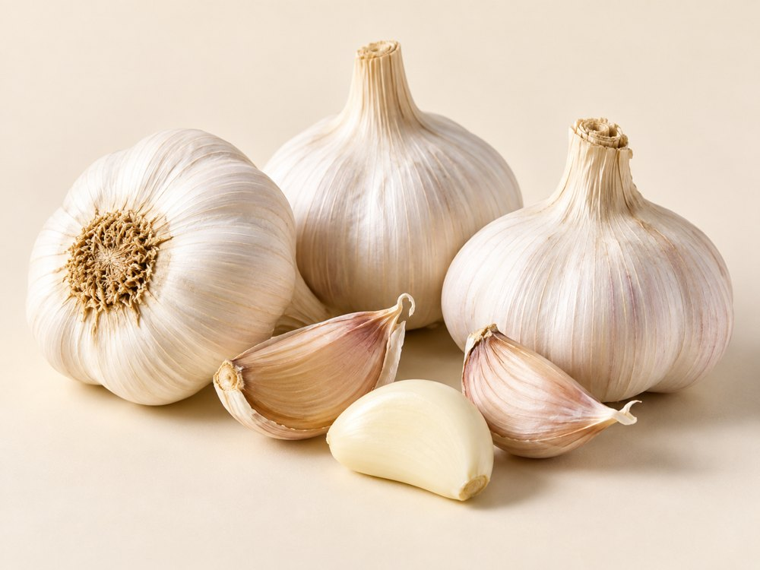
TASHI GLOBAL
Garlic
VARIETIES & FORMS
White-bulb selections including Yamuna Safed types. Whole cured bulbs, large-bulb grades or peeled cloves.
BUYING SPECIFICATIONS & USES
Agree diameter, clove uniformity, dryness and sprouting limits. Peeled garlic requires separate storage; used in cooking and seasoning.
HANDLING
Keep dry and protected from moisture, pests and contamination. Agree ventilation and storage conditions for the supplied form.
tashiglobal.com | 12
Notes:
Company information supplied by Tashi Global. Product descriptions adapted from the approved website. AI-generated product images are illustrations. Product descriptions are general buying guidance. Varieties, origin, availability, quality limits, packaging, quantity, price and delivery terms are confirmed in the quotation and contract. AI-generated images are illustrative and do not represent a specific shipment.

Slide 13
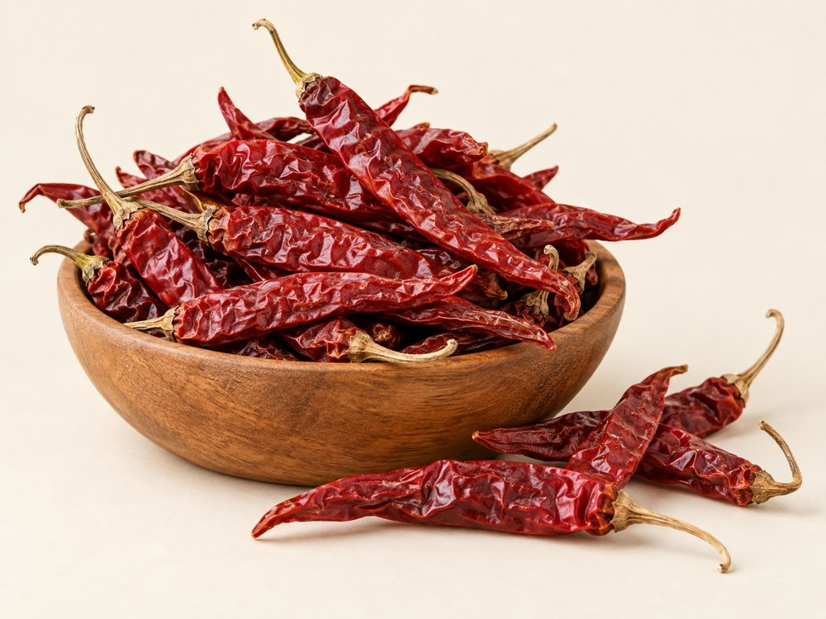
TASHI GLOBAL
Red Dry Chillies
VARIETIES & FORMS
Byadagi Kaddi: colour-focused and milder. Guntur Sannam: pungent. Bird’s Eye: small and hot. Heat varies by crop.
BUYING SPECIFICATIONS & USES
Specify stem-on or stemless, whole or crushed, heat, colour and moisture. Used in sauces, blends and seasonings.
HANDLING
Keep dry and protected from moisture, pests and contamination. Agree ventilation and storage conditions for the supplied form.
tashiglobal.com | 13
Notes:
Company information supplied by Tashi Global. Product descriptions adapted from the approved website. AI-generated product images are illustrations. Product descriptions are general buying guidance. Varieties, origin, availability, quality limits, packaging, quantity, price and delivery terms are confirmed in the quotation and contract. AI-generated images are illustrative and do not represent a specific shipment.

Slide 14
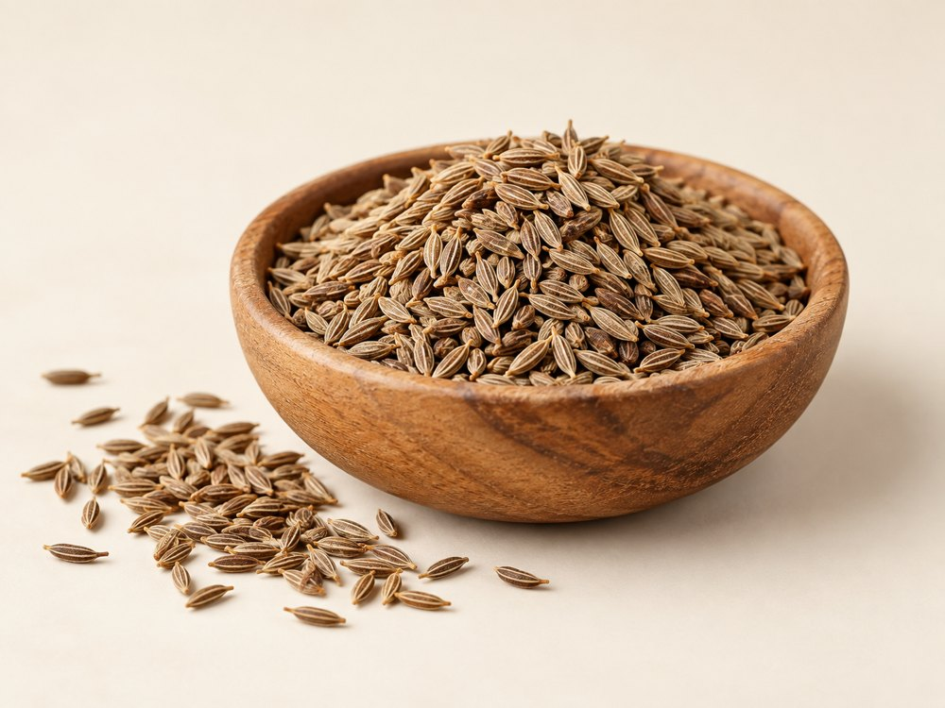
TASHI GLOBAL
Cumin Seeds
VARIETIES & FORMS
Named cultivars include GC 1 and RZ 19. Cleaned and colour-sorted grades describe processing rather than botanical varieties.
BUYING SPECIFICATIONS & USES
Agree purity, moisture, aroma and foreign matter. Used whole or ground in savoury dishes and spice blends.
HANDLING
Keep dry and protected from moisture, pests and contamination. Agree ventilation and storage conditions for the supplied form.
tashiglobal.com | 14
Notes:
Company information supplied by Tashi Global. Product descriptions adapted from the approved website. AI-generated product images are illustrations. Product descriptions are general buying guidance. Varieties, origin, availability, quality limits, packaging, quantity, price and delivery terms are confirmed in the quotation and contract. AI-generated images are illustrative and do not represent a specific shipment.

Slide 15
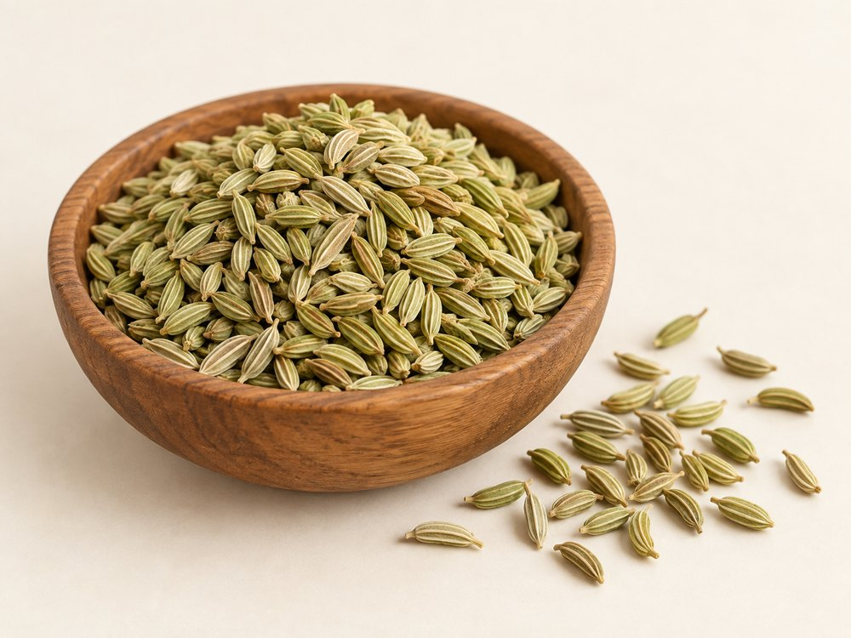
TASHI GLOBAL
Fennel Seeds
VARIETIES & FORMS
CO 1, Gujarat Fennel 1, PF 35 and UF 32 are named selections. Trade grades may focus on bold size or green colour.
BUYING SPECIFICATIONS & USES
Specify seed size, colour, aroma, purity and moisture for cooking, bakery, confectionery or infusions.
HANDLING
Keep dry and protected from moisture, pests and contamination. Agree ventilation and storage conditions for the supplied form.
tashiglobal.com | 15
Notes:
Company information supplied by Tashi Global. Product descriptions adapted from the approved website. AI-generated product images are illustrations. Product descriptions are general buying guidance. Varieties, origin, availability, quality limits, packaging, quantity, price and delivery terms are confirmed in the quotation and contract. AI-generated images are illustrative and do not represent a specific shipment.

Slide 16
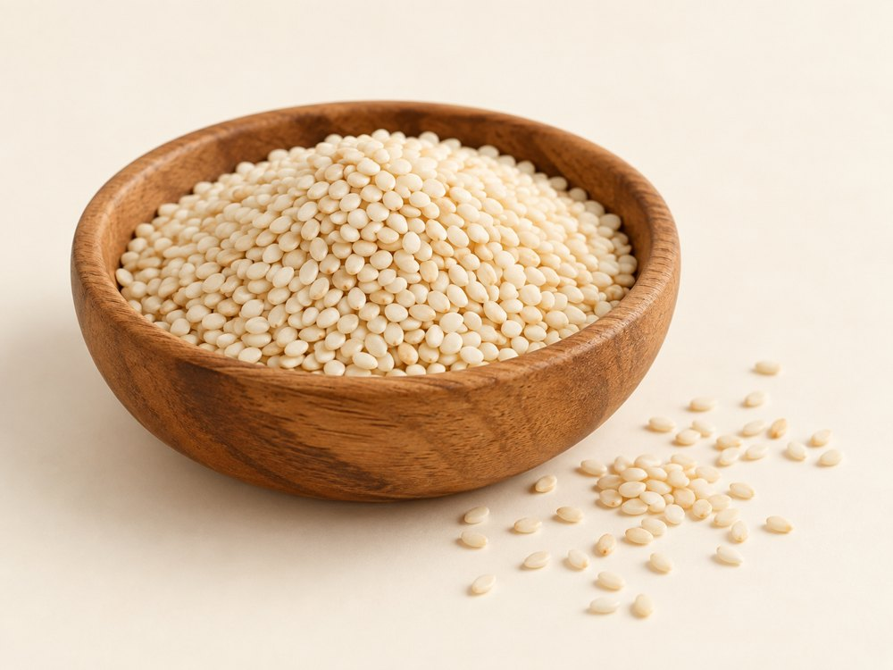
TASHI GLOBAL
Sesame Seeds
VARIETIES & FORMS
Natural white, black or brown seeds; hulled seeds; raw or toasted forms. Hulling is a processing step.
BUYING SPECIFICATIONS & USES
Agree colour, purity, moisture and residual hulls for bakery, pastes or food use. Sesame is an allergen.
HANDLING
Keep dry and protected from moisture, pests and contamination. Agree ventilation and storage conditions for the supplied form.
tashiglobal.com | 16
Notes:
Company information supplied by Tashi Global. Product descriptions adapted from the approved website. AI-generated product images are illustrations. Product descriptions are general buying guidance. Varieties, origin, availability, quality limits, packaging, quantity, price and delivery terms are confirmed in the quotation and contract. AI-generated images are illustrative and do not represent a specific shipment.

Slide 17
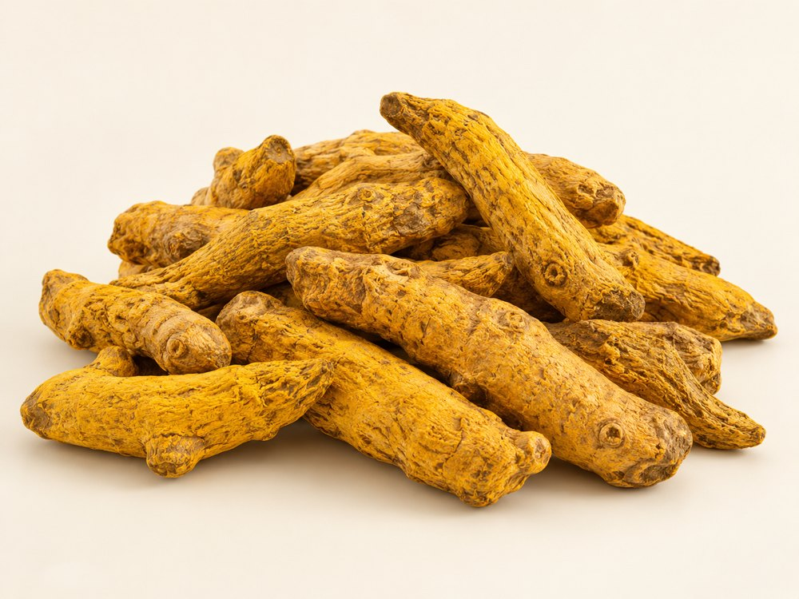
TASHI GLOBAL
Turmeric Finger
VARIETIES & FORMS
Erode local: shorter curved fingers. Salem: larger, longer fingers. Prathibha: a named selection. Polished or unpolished forms.
BUYING SPECIFICATIONS & USES
Agree colour, moisture, finger size, broken pieces and required curcumin testing. Used for grinding and spice processing.
HANDLING
Keep dry and protected from moisture, pests and contamination. Agree ventilation and storage conditions for the supplied form.
tashiglobal.com | 17
Notes:
Company information supplied by Tashi Global. Product descriptions adapted from the approved website. AI-generated product images are illustrations. Product descriptions are general buying guidance. Varieties, origin, availability, quality limits, packaging, quantity, price and delivery terms are confirmed in the quotation and contract. AI-generated images are illustrative and do not represent a specific shipment.

Slide 18
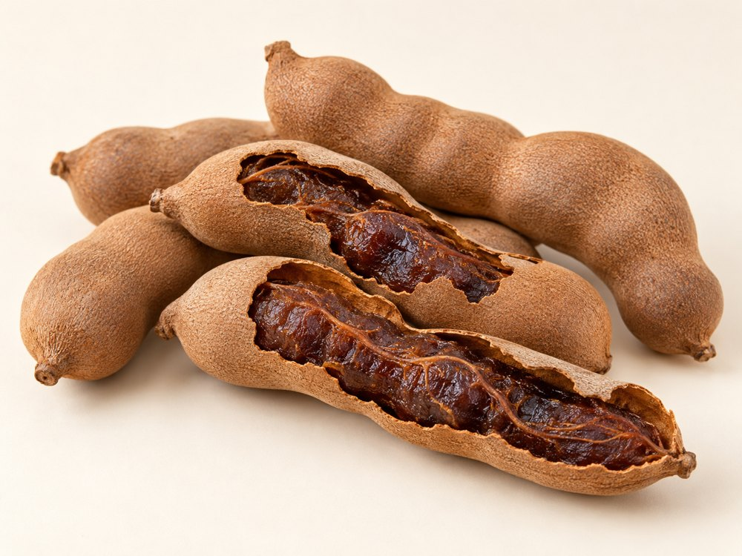
TASHI GLOBAL
Tamarind
VARIETIES & FORMS
Sour types for cooking; sweet types for snacking; whole pods, seeded or seedless pulp and paste.
BUYING SPECIFICATIONS & USES
Specify sweetness or acidity, seed and fibre content, pulp colour and moisture. Used in sauces, drinks and confectionery.
HANDLING
Keep dry and protected from moisture, pests and contamination. Agree ventilation and storage conditions for the supplied form.
tashiglobal.com | 18
Notes:
Company information supplied by Tashi Global. Product descriptions adapted from the approved website. AI-generated product images are illustrations. Product descriptions are general buying guidance. Varieties, origin, availability, quality limits, packaging, quantity, price and delivery terms are confirmed in the quotation and contract. AI-generated images are illustrative and do not represent a specific shipment.

Slide 19
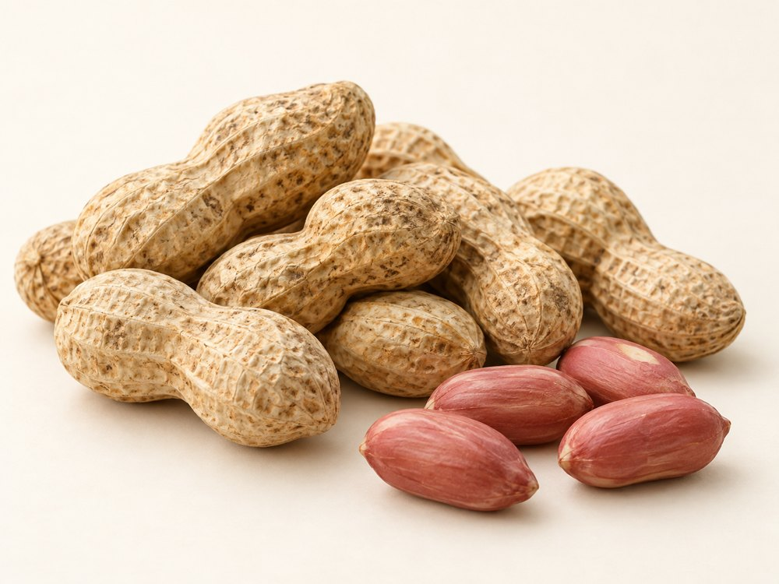
TASHI GLOBAL
Groundnut (Peanuts)
VARIETIES & FORMS
Runner: uniform kernels. Virginia: larger kernels. Spanish: smaller reddish-skinned kernels. Valencia: often several kernels per pod.
BUYING SPECIFICATIONS & USES
Agree in-shell or kernel form, count basis, moisture and food-safety tests. Used for snacks and ingredients. Peanut allergen applies.
HANDLING
Keep dry and protected from moisture, pests and contamination. Agree ventilation and storage conditions for the supplied form.
tashiglobal.com | 19
Notes:
Company information supplied by Tashi Global. Product descriptions adapted from the approved website. AI-generated product images are illustrations. Product descriptions are general buying guidance. Varieties, origin, availability, quality limits, packaging, quantity, price and delivery terms are confirmed in the quotation and contract. AI-generated images are illustrative and do not represent a specific shipment.

Slide 20
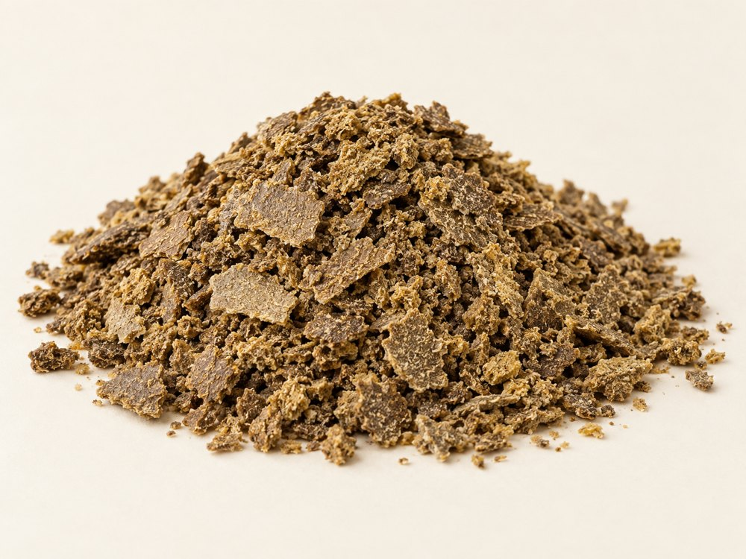
TASHI GLOBAL
Rapeseed Meal
VARIETIES & FORMS
Solvent-extracted meal; mechanically pressed expeller cake; canola-quality meal. Composition depends on the process.
BUYING SPECIFICATIONS & USES
Agree protein, moisture, fibre, residual oil, glucosinolates and analytical basis. A feed ingredient; confirm suitability with the feed formulator.
HANDLING
Keep dry and protected from moisture, pests and contamination. Agree ventilation and storage conditions for the supplied form.
tashiglobal.com | 20
Notes:
Company information supplied by Tashi Global. Product descriptions adapted from the approved website. AI-generated product images are illustrations. Product descriptions are general buying guidance. Varieties, origin, availability, quality limits, packaging, quantity, price and delivery terms are confirmed in the quotation and contract. AI-generated images are illustrative and do not represent a specific shipment.

Slide 21
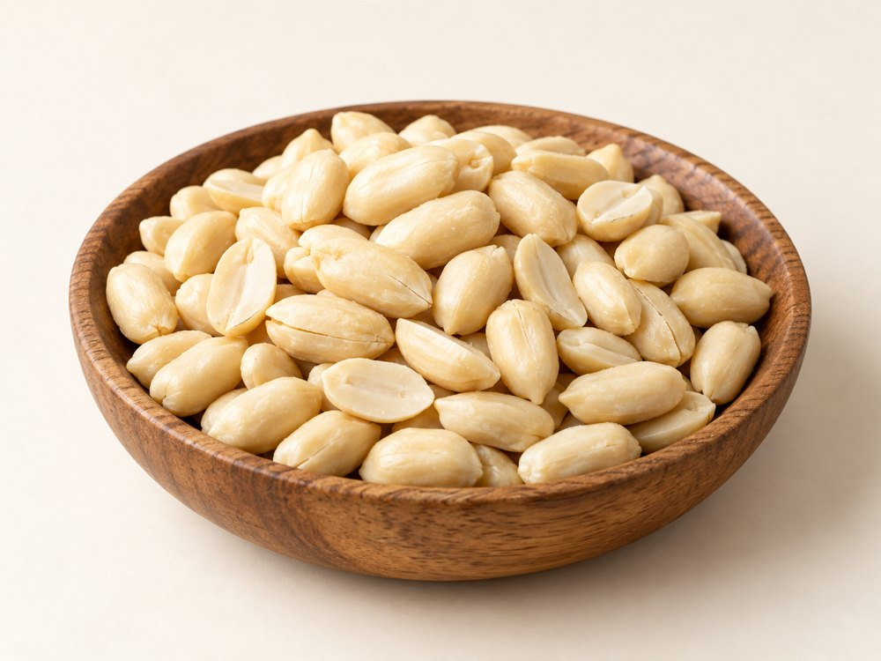
TASHI GLOBAL
Blanched Peanuts
VARIETIES & FORMS
Whole kernels, split kernels and sized pieces. Blanching removes skins; confirm the original peanut type separately.
BUYING SPECIFICATIONS & USES
Specify size, residual skin, raw or roasted status and testing. Blanching alone does not mean ready-to-eat. Peanuts are an allergen.
HANDLING
Keep dry and protected from moisture, pests and contamination. Agree ventilation and storage conditions for the supplied form.
tashiglobal.com | 21
Notes:
Company information supplied by Tashi Global. Product descriptions adapted from the approved website. AI-generated product images are illustrations. Product descriptions are general buying guidance. Varieties, origin, availability, quality limits, packaging, quantity, price and delivery terms are confirmed in the quotation and contract. AI-generated images are illustrative and do not represent a specific shipment.

Slide 22
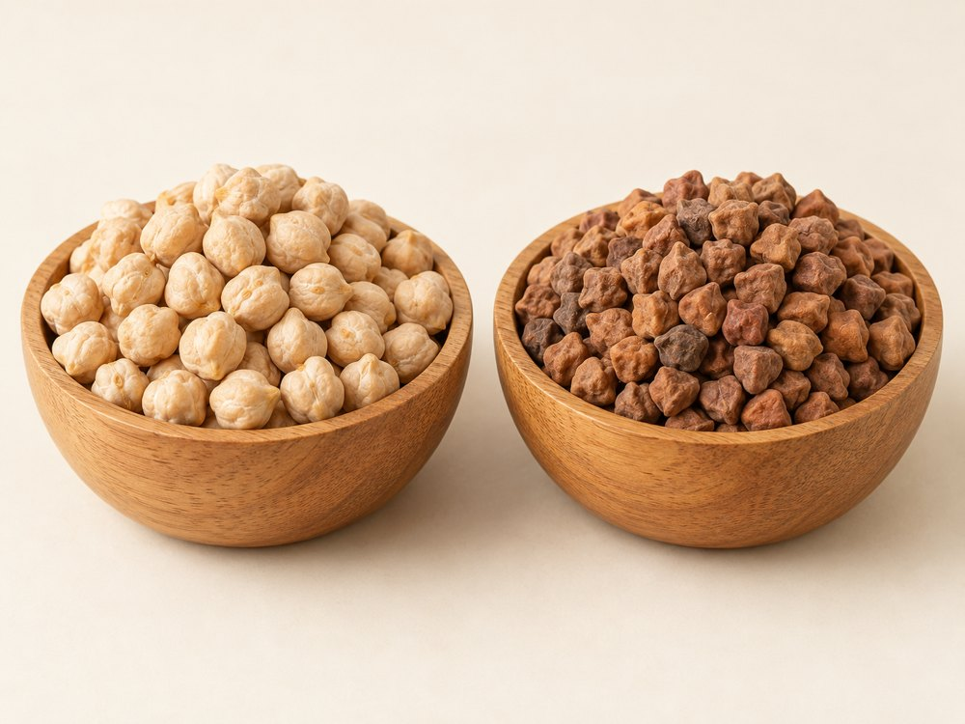
TASHI GLOBAL
Chickpeas (Kabuli & Desi)
VARIETIES & FORMS
Kabuli: larger, lighter seeds. Desi: smaller, darker, more angular seeds. Split, dehulled Desi is a processed form.
BUYING SPECIFICATIONS & USES
Agree grain size, colour, moisture, purity and damage limits. Used for curries, hummus, flour and pulse processing.
HANDLING
Keep dry and protected from moisture, pests and contamination. Agree ventilation and storage conditions for the supplied form.
tashiglobal.com | 22
Notes:
Company information supplied by Tashi Global. Product descriptions adapted from the approved website. AI-generated product images are illustrations. Product descriptions are general buying guidance. Varieties, origin, availability, quality limits, packaging, quantity, price and delivery terms are confirmed in the quotation and contract. AI-generated images are illustrative and do not represent a specific shipment.

Slide 23
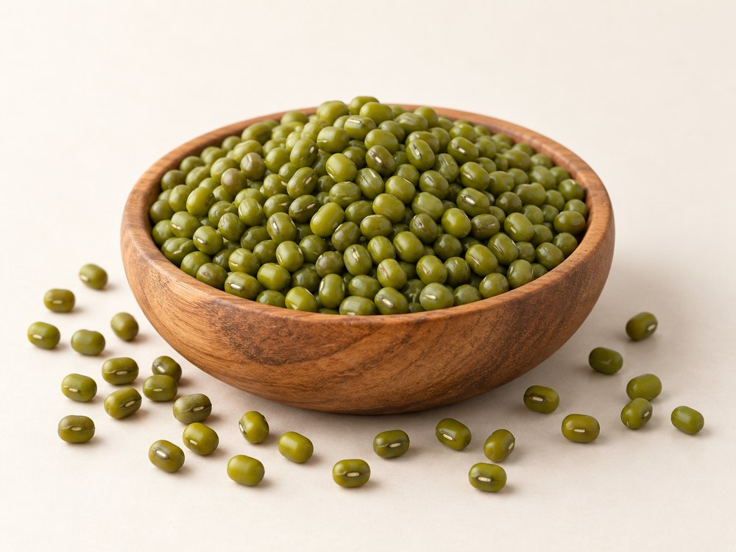
TASHI GLOBAL
Green Moong Beans
VARIETIES & FORMS
Named cultivars include Jade-AU and Crystal. Whole green beans, split skin-on beans and dehulled yellow beans.
BUYING SPECIFICATIONS & USES
Specify size, moisture, purity and damage. Sprouting needs separate germination and food-safety checks; also used in cooked dishes and flour.
HANDLING
Keep dry and protected from moisture, pests and contamination. Agree ventilation and storage conditions for the supplied form.
tashiglobal.com | 23
Notes:
Company information supplied by Tashi Global. Product descriptions adapted from the approved website. AI-generated product images are illustrations. Product descriptions are general buying guidance. Varieties, origin, availability, quality limits, packaging, quantity, price and delivery terms are confirmed in the quotation and contract. AI-generated images are illustrative and do not represent a specific shipment.

Slide 24
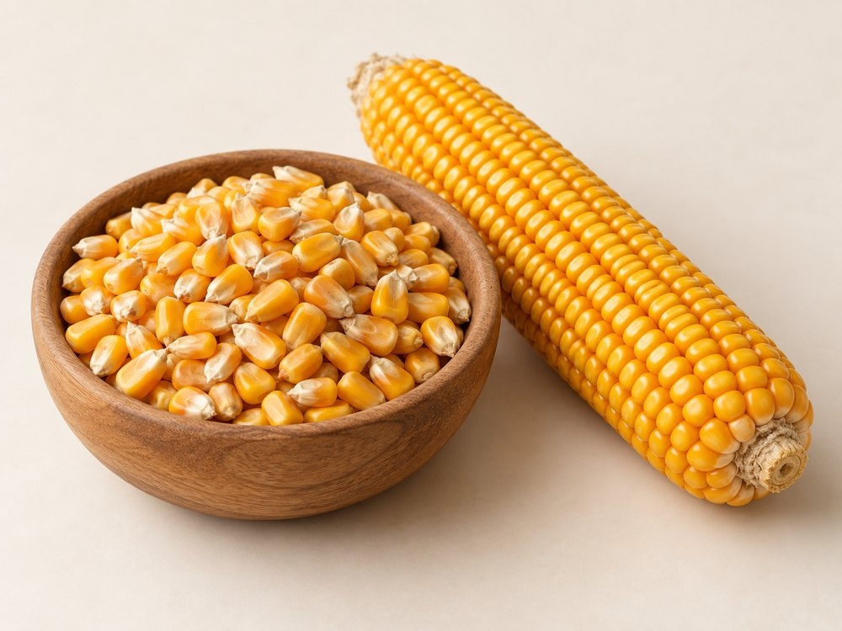
TASHI GLOBAL
Maize (Corn)
VARIETIES & FORMS
Dent: field corn. Flint: harder kernels. Popcorn: selected for expansion. Sweet corn: fresh or processed vegetable.
BUYING SPECIFICATIONS & USES
For dry grain, agree moisture, colour, test weight and impurities. Food, feed and industrial grades differ; sweet corn needs separate handling.
HANDLING
Keep dry and protected from moisture, pests and contamination. Agree ventilation and storage conditions for the supplied form.
tashiglobal.com | 24
Notes:
Company information supplied by Tashi Global. Product descriptions adapted from the approved website. AI-generated product images are illustrations. Product descriptions are general buying guidance. Varieties, origin, availability, quality limits, packaging, quantity, price and delivery terms are confirmed in the quotation and contract. AI-generated images are illustrative and do not represent a specific shipment.

Slide 25
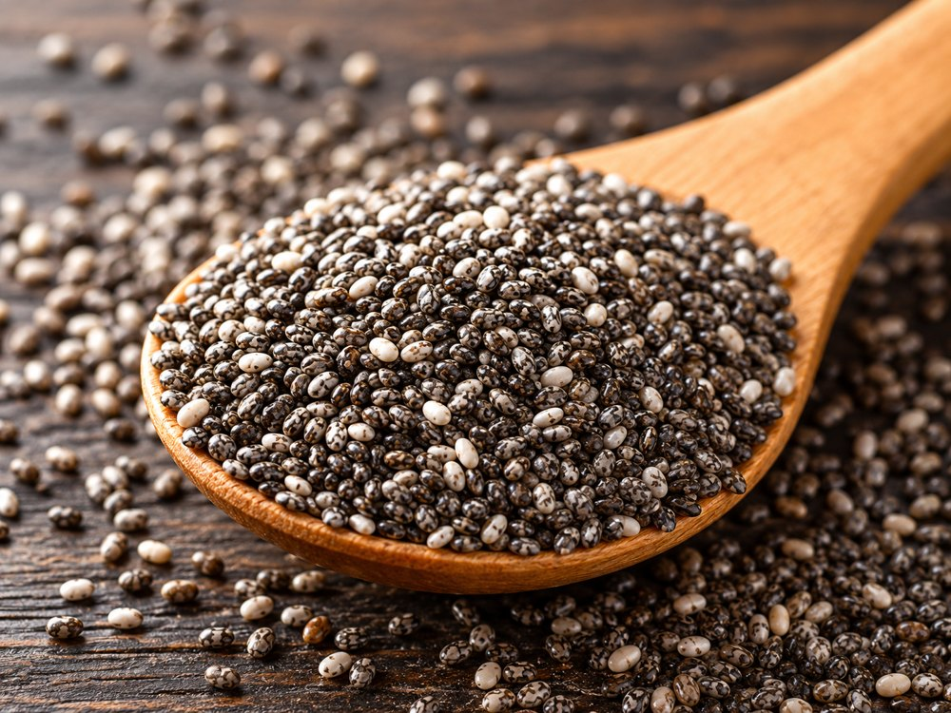
TASHI GLOBAL
Chia Seeds
VARIETIES & FORMS
Black chia: mixed dark mottled seeds. White chia: selected light seeds. Whole and milled forms are distinct.
BUYING SPECIFICATIONS & USES
Agree colour, purity, moisture and cleaning. Milled chia also needs a particle-size specification. Used in bakery, cereals and beverages.
HANDLING
Keep dry and protected from moisture, pests and contamination. Agree ventilation and storage conditions for the supplied form.
tashiglobal.com | 25
Notes:
Company information supplied by Tashi Global. Product descriptions adapted from the approved website. AI-generated product images are illustrations. Product descriptions are general buying guidance. Varieties, origin, availability, quality limits, packaging, quantity, price and delivery terms are confirmed in the quotation and contract. AI-generated images are illustrative and do not represent a specific shipment.

Slide 26

TASHI GLOBAL
Product enquiries
Tashi Global Trading Company Limited
Vietnam
tashiservices@gmail.com
+84 853 891 092
tashiglobal.com
WeChat: wxid_7odlj2723fzd12
WhatsApp and Zalo available on our website.
Product descriptions are general buying guidance. Varieties, origin, availability, quality limits, packaging, quantity, price and delivery terms are confirmed in the quotation and contract. AI-generated images are illustrative and do not represent a specific shipment.
Scan for digital version
tashiglobal.com | 26
Notes:
Company information supplied by Tashi Global. Product descriptions adapted from the approved website. AI-generated product images are illustrations. Product descriptions are general buying guidance. Varieties, origin, availability, quality limits, packaging, quantity, price and delivery terms are confirmed in the quotation and contract. AI-generated images are illustrative and do not represent a specific shipment.

